Slide 1
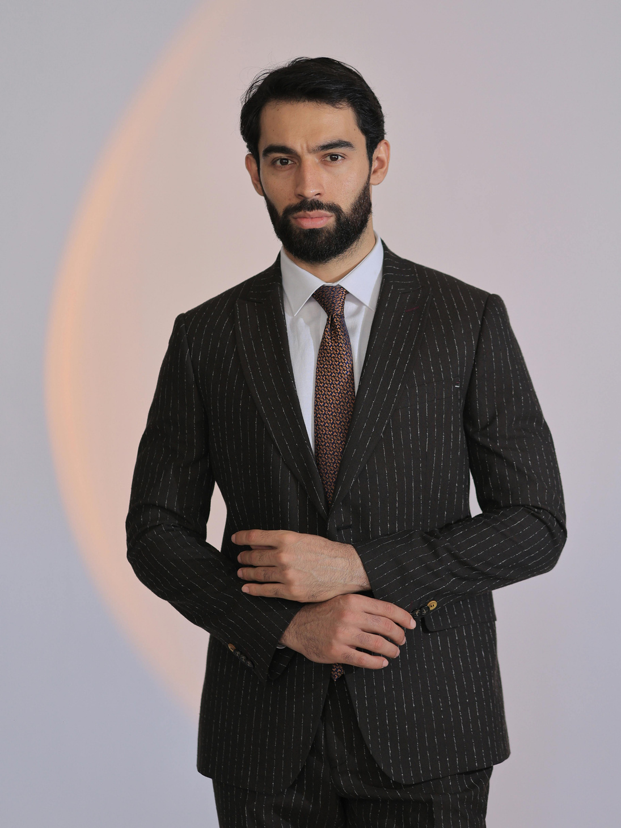
REESE MILLER
Social Media Manager
SUMMARY
Creative and results-oriented Social Media Manager with experience in developing and executing effective social media strategies across multiple platforms. Skilled in content creation, campaign planning, and audience engagement to strengthen brand identity and increase online visibility. Experienced in analyzing social media metrics to optimize performance and improve engagement rates. Passionate about digital trends, storytelling, and creating meaningful connections between brands and their audiences.
CONTACT
PHONE
+123-456-7890
ADDRESS
123 Anywhere St., Any City
EMAIL
EDUCATION
hello@reallygreatsite.com
Borcelle University
2018-2022
WORK EXPERIENCE
Bachelor of Marketing Communications
Arowwai Industries
2024-2026
Focused on digital communication strategies, social media marketing, and online content creation.
Social Media Manager
Increased average engagement rate by 35% through creative content strategies.
Managed social media accounts for 8+ clients across any platforms.
SKILLS
Social Media Strategy
Content Planning
Copywriting
Social Media Analytics
Community Management
Trend Research
Hootsuite, Buffer
Fradel and Spies Co
2022-2024
Social Media Manager
Planned monthly content calendars and coordinated with design teams.

